Slide 1

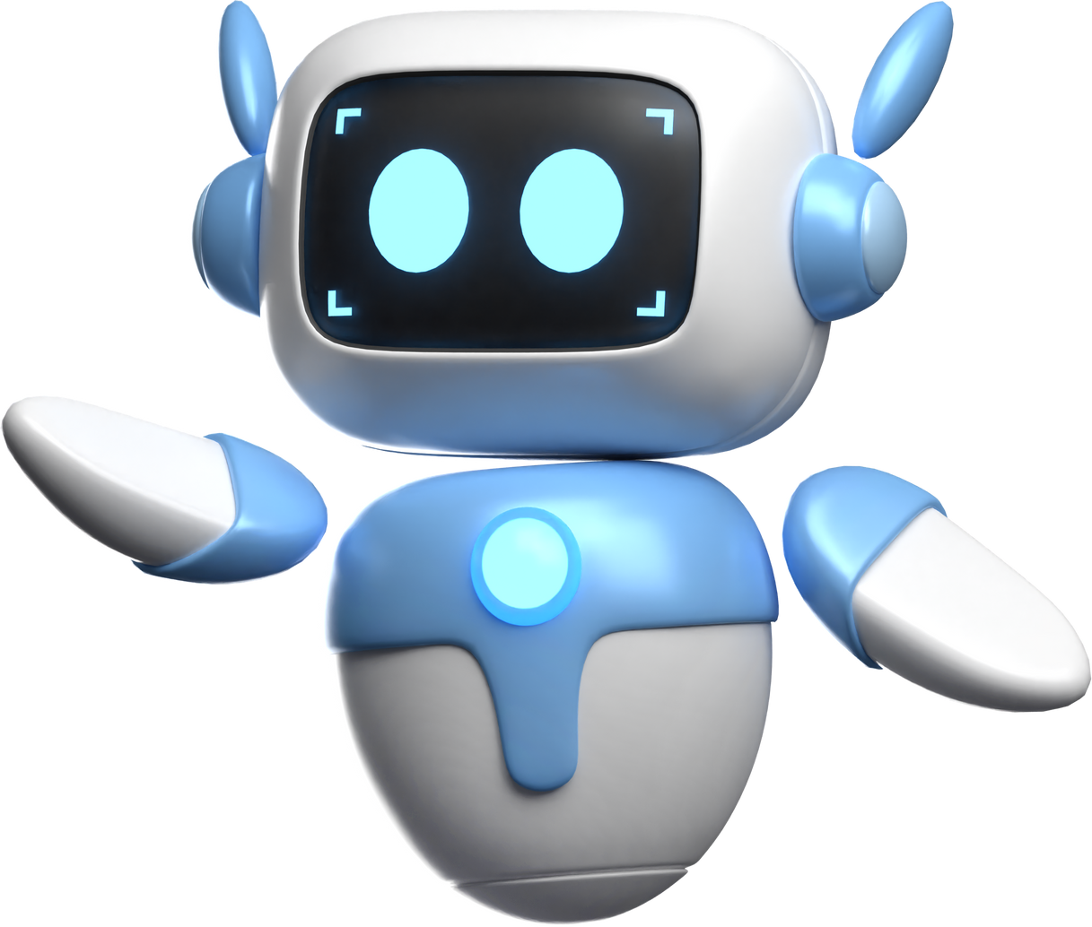
AI TOOLS
to Enhance Language Skills

Slide 2
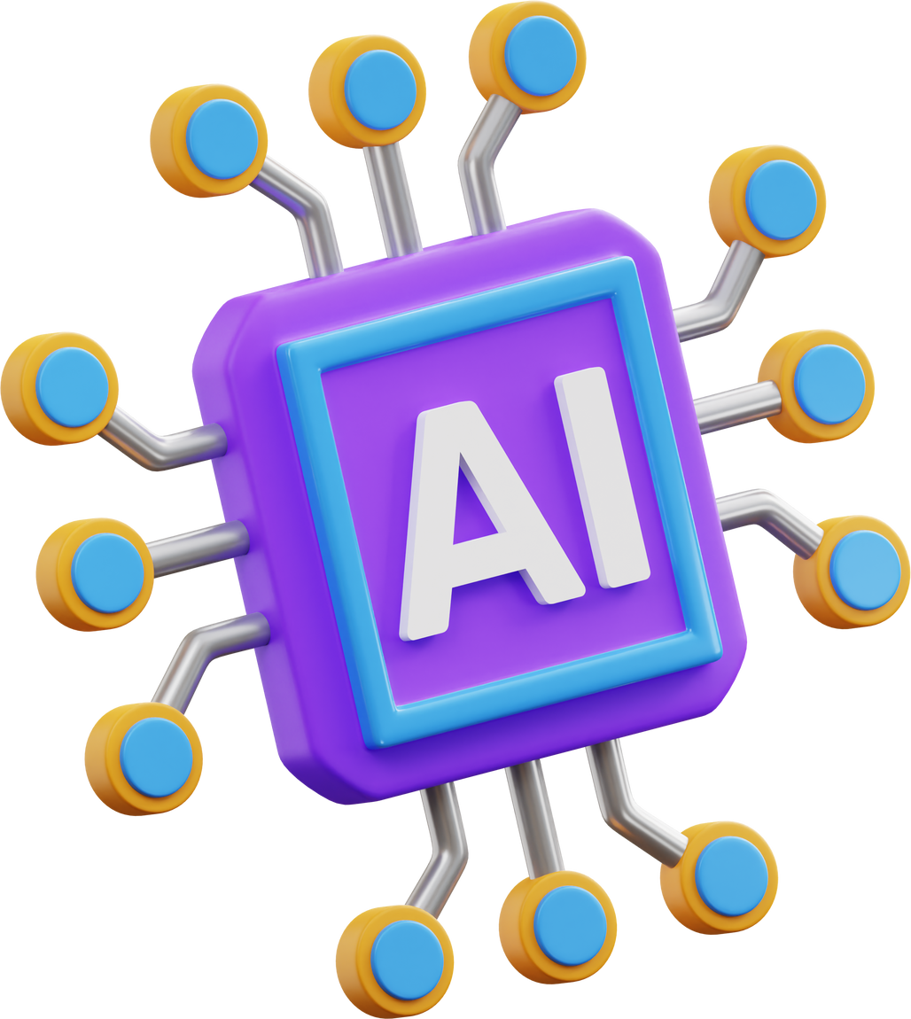


CONTENTS
1
What is AI?
2
The role of AI in Language Learning
3
Benefits of AI tools in Language Learning
4
Potential Problems
5
AI Tools Practical Uses

Slide 3



1
What is AI?
Artificial Intelligence (AI) refers to the simulation of human intelligence processes by machines, allowing them to perform tasks that typically require human cognitive functions.
AI systems can analyse data, learn from it, and make decisions or perform actions based on that data.

Slide 4



2
the role of ai in language learning
PERSONALISED LEARNING EXPERIENCES
LANGUAGE CORRECTION
INSTANT FEEDBACK

Slide 5


3
Benefits of AI tools in Language Learning
enhanced writing skills
enhanced speaking skills
AI tools can identify and correct grammar and style errors, helping students produce more polished written work.
AI tools can recognise speech and provide guidance on pronunciation, aiding students in developing better speaking skills.

Slide 6


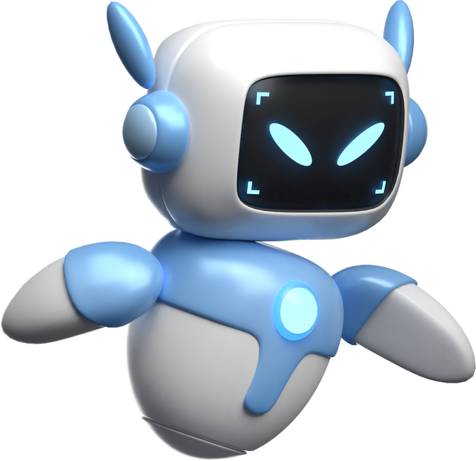
4
potential problems
DEPENDENCE ON TECHNOLOGY
PRIVACY AND DATA CONCERNS

Slide 7
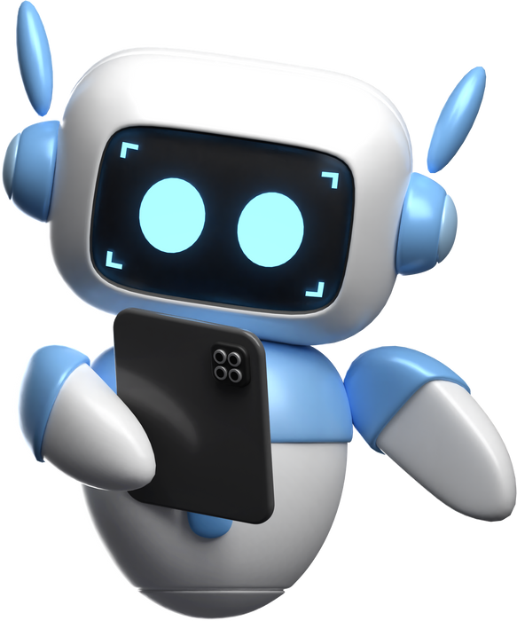
5
ai tools practical uses
Grammar and Style Correction
Accuracy and appropriacy
Speech Recognition
Pronunciation improvement
Language Translation
Vocabulary enhancement
Content Recommendation
Personalised learning
Language Learning Apps
Language assessment

